Slide 2
CAN – CAN’T
ABILITIES

Slide 3

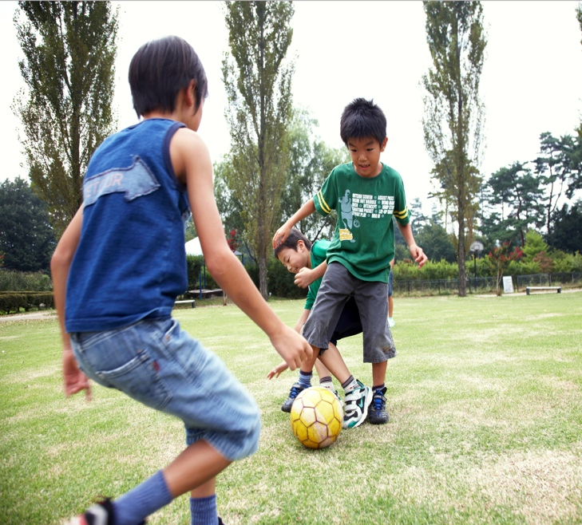
Look and read.
They can play soccer.
They can’t play soccer.
Notes:
TEACHER: Have students look at the pictures and read the sentences. Tell them the boys know how to play soccer, they have the ability to play soccer, while the kids on the right don’t have the same ability. Have them read the sentences out loud and encourage them to answer the question And you, can you play soccer? using Yes, I can. / No, I can’t.

Slide 4
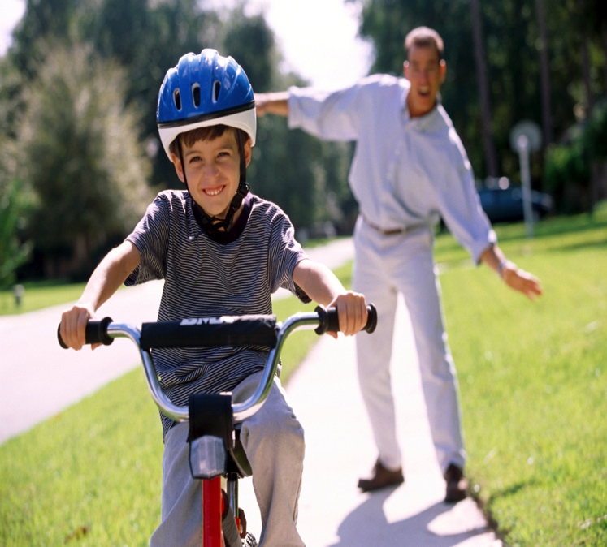
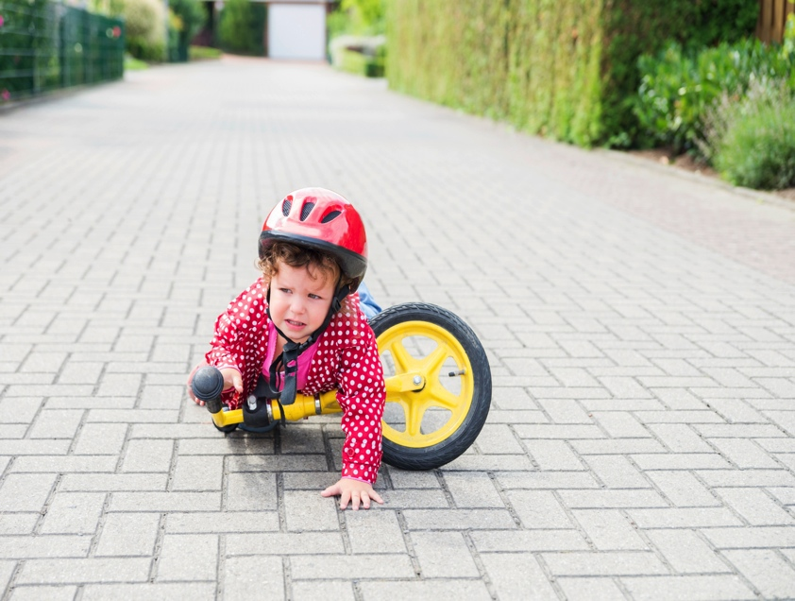
Look and read.
Ian can ride a bike.
Leo can’t ride a bike.
Notes:
TEACHER: : Have students look at the pictures and read the sentences. Tell them Ian knows how to ride a bike, he has the ability to ride a bike, while Leo doesn’t have the same ability. Have them read the sentences out loud and encourage them to answer the question And you, can you ride a bike? using Yes, I can. / No, I can’t.

Slide 5
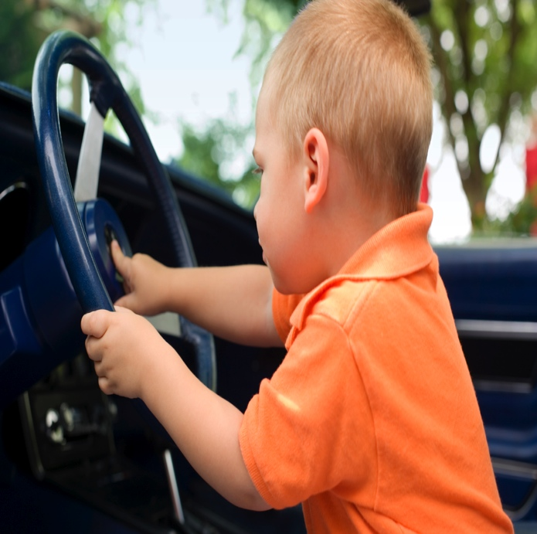
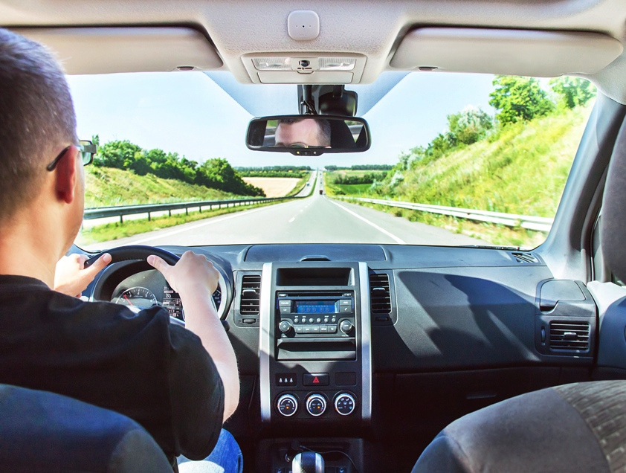
Look and read.
David can’t drive.
Tom can drive.
Notes:
TEACHER: Have students look at the pictures and read the sentences. Tell them David doesn’t know how to drive, he doesn’t have the ability to drive, while Tom does. Have them read the sentences out loud and encourage them to answer the question And you, can you drive? using Yes, I can. / No, I can’t.

Slide 6
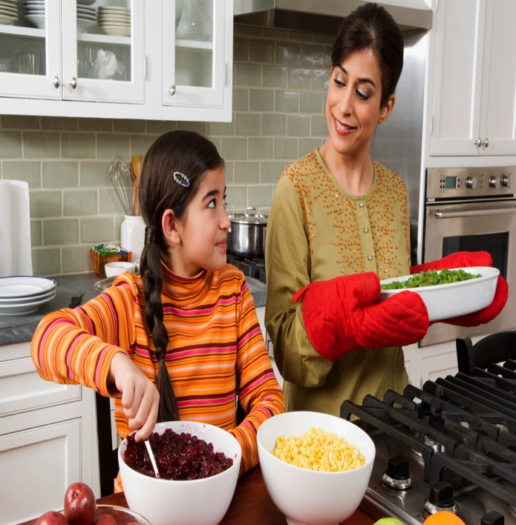
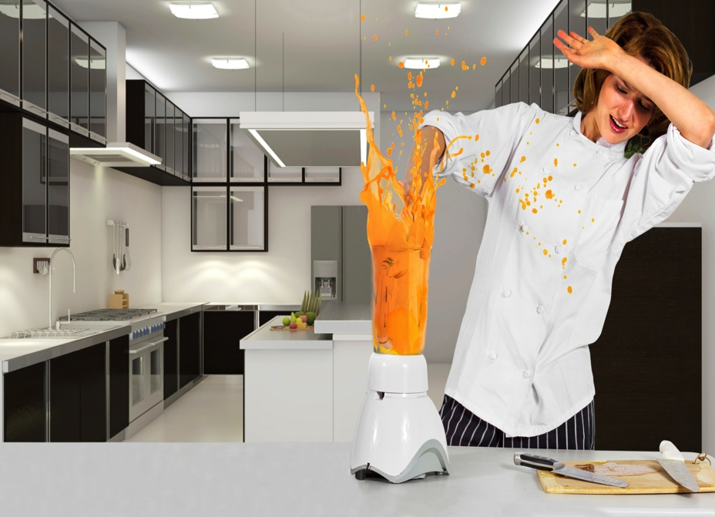
Look and read.
Mary can cook.
I can’t cook.
Notes:
TEACHER: Have students look at the pictures and read the sentences. Tell them Mary knows how to cook, she has the ability to cook, while I don’t. Have them read the sentences out loud and encourage them to answer the question And you, can you cook? using Yes, I can. / No, I can’t.

Slide 7

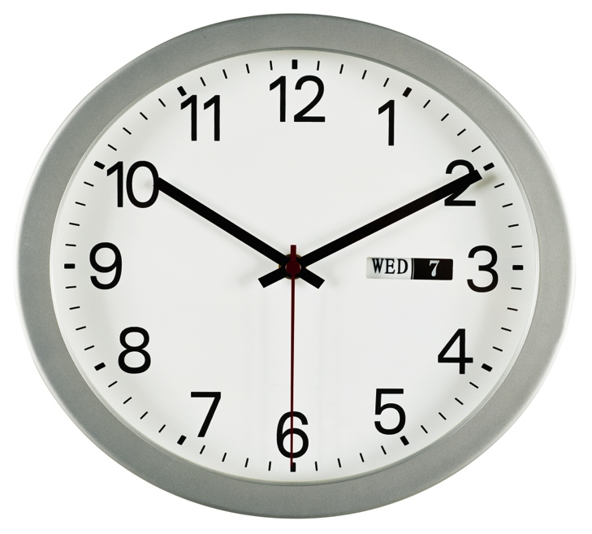
Look and read.
It can tell the time.
It can’t tell the time, but it can take pictures.
Notes:
TEACHER: Have students look at the picture and read the sentence. Tell them the girl knows how to dance, she has the ability to dance. Have them read the sentence out loud and encourage them to answer the question using Yes, I can. / No, I can’t.

Slide 8
AFFIRMATIVE FORM
Look at the chart.
P. PRONOUN
VERB
I
YOU
HE
SHE
IT
WE
YOU
THEY
SWIM.
.
SWIM.
CAN
SWIM.
SWIM.
SWIM.
SWIM.
SWIM.
SWIM.
Notes:
TEACHER: Ask students to look at the chart and check the affirmative form.

Slide 9
NEGATIVE FORM
Look at the chart.
P. PRONOUN
VERB
I
YOU
HE
SHE
IT
WE
YOU
THEY
SWIM.
.
SWIM.
CAN’T
SWIM.
SWIM.
SWIM.
SWIM.
SWIM.
SWIM.
Notes:
TEACHER: Ask students to look at the chart and check the negative form.

Slide 10
INTERROGATIVE FORM
Look at the chart.
P. PRONOUN
VERB
I
YOU
HE
SHE
IT
WE
YOU
THEY
SWIM?
SWIM?
CAN
SWIM?
SWIM?
SWIM?
SWIM?
SWIM?
SWIM?
Notes:
TEACHER: Ask students to look at the chart and check the interrogative form.

Slide 11
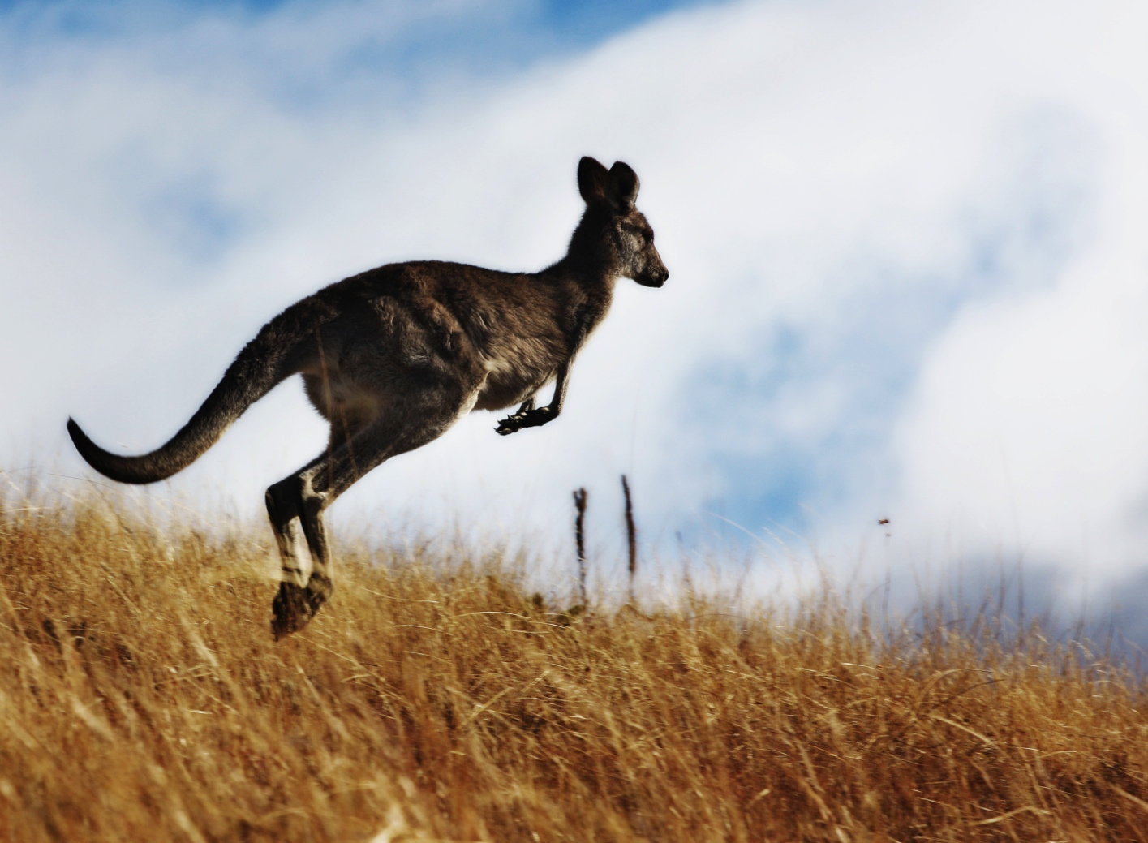
ASK QUESTIONS. USE THE CUES.
a kangaroo / jump
Notes:
TEACHER: Get students to ask a partner a question related to the picture, using the cues given.

Slide 12
CHECK.
Can a kangaroo jump?
Notes:
TEACHER: Tell students to check the question and the correct answer.

Slide 13
CHECK.
Can a kangaroo jump?
Yes, it can.
Notes:
TEACHER: Tell students to check the question and the correct answer.

Slide 14
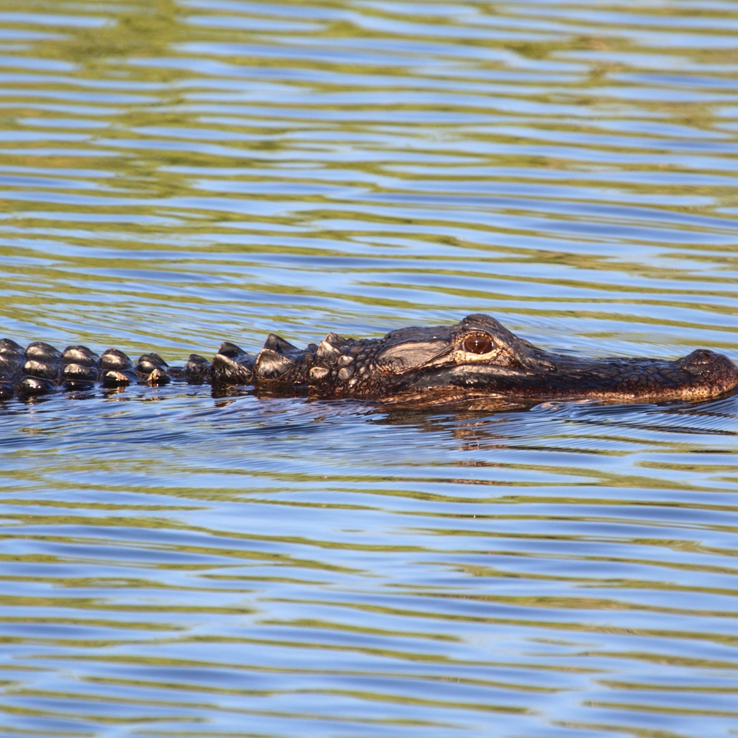
ASK QUESTIONS. USE THE CUES.
an alligator / fly
Notes:
TEACHER: Get students to ask a partner a question related to the picture, using the cues given.

Slide 15
CHECK.
Can an alligator fly?
Notes:
TEACHER: Tell students to check the question and the correct answer.

Slide 16
CHECK.
Can an alligator fly?
No, it can’t.
Notes:
TEACHER: Tell students to check the question and the correct answer.

Slide 17

ASK QUESTIONS. USE THE CUES.
a butterfly / fly
Notes:
TEACHER: Get students to ask a partner a question related to the picture, using the cues given.

Slide 18
CHECK.
Can a butterfly fly?
Notes:
TEACHER: Get students to ask a partner a question related to the picture, using the cues given.

Slide 19
CHECK.
Can a butterfly fly?
Yes, it can.
Notes:
TEACHER: Get students to ask a partner a question related to the picture, using the cues given.

Slide 20
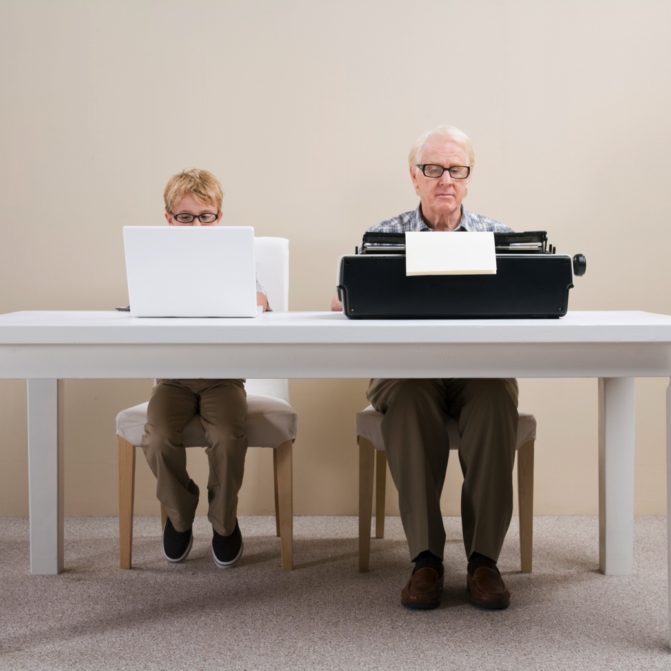
ASK QUESTIONS. USE THE CUES.
grandpa / use the computer
Notes:
TEACHER: Get students to ask a partner a question related to the picture, using the cues given.

Slide 21
CHECK.
Can grandpa use the computer?
Notes:
TEACHER: Tell students to check the question and the correct answer.

Slide 22
CHECK.
Can grandpa use the computer?
No, he can’t.
Notes:
TEACHER: Tell students to check the question and the correct answer.

Slide 23
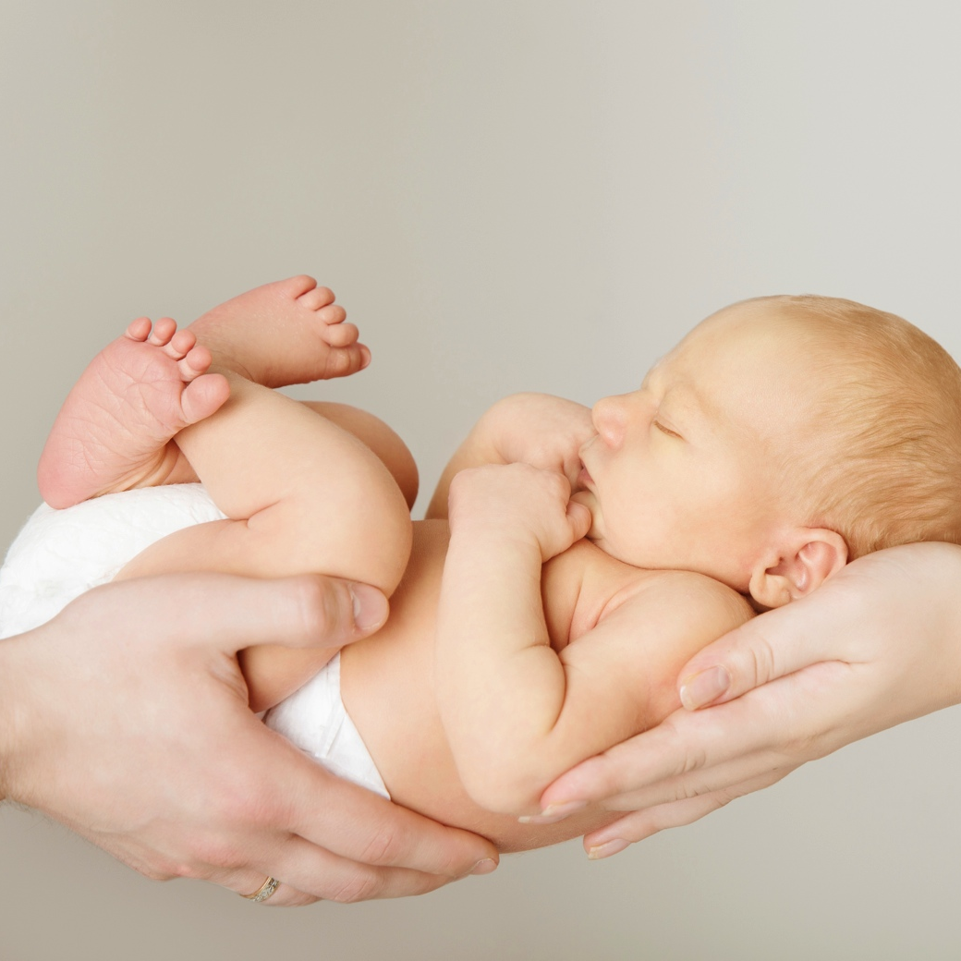
ASK QUESTIONS. USE THE CUES.
a baby / walk
Notes:
TEACHER: Get students to ask a partner a question related to the picture, using the cues given.

Slide 24
CHECK.
Can a baby walk?
Notes:
TEACHER: Tell students to check the question and the correct answer.

Slide 25
CHECK.
Can a baby walk?
No, he can’t.
Notes:
TEACHER: Tell students to check the question and the correct answer.

Slide 26
NOW, YOU.
SURF
PLAY THE GUITAR
COUNT TO TEN IN JAPANESE
PLAY VIDEO GAMES
JUMP ROPE
DO JUDO
PLAY TENNIS
Notes:
TEACHER: Say I can jump rope and play tennis, but I can’t surf. Ask students to make up true sentences about themselves using the cues given. Encourage them to use the same language prompts you did. Then, they should compare their sentences to their friends’ and check what they have in common.

Slide 27
Thanks!

