Slide 2
PASSIVE VOICE
Simple Present

Slide 3
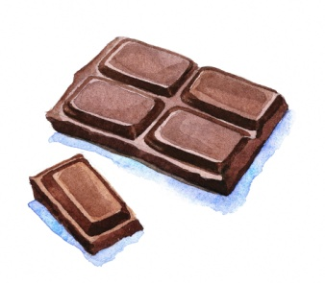
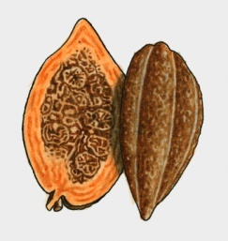

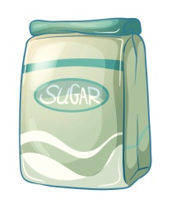
Look and read.
=
Chocolate is made with cocoa, milk and sugar.
Answer:
Is there a subject in the sentence above?
Who makes chocolate?
Notes:
TEACHER: Ask students to read and analyse the sentences by answering the questions. Draw their attention to the fact that it’s not important to know who makes chocolate.

Slide 4
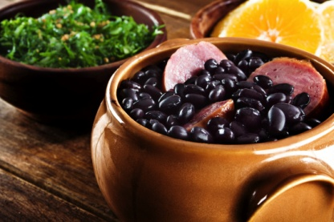
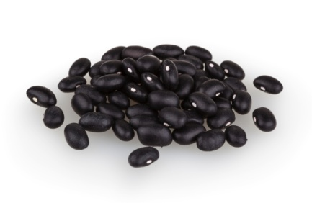
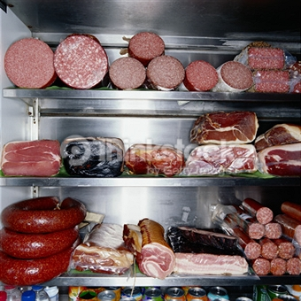
Look and read.
=
Feijoada is made with black beans and pork.
Answer:
Is there a subject in the sentence above?
Who makes feijoada?
Notes:
TEACHER: Ask students to read and analyse the sentences by answering the questions. Draw their attention to the fact that it’s not important to know who makes feijoada.

Slide 5
Attention!
The sentences you’ve just read are in the Passive Voice.
The Passive Voice is used when the consequence is more important than the subject.
Notes:
TEACHER: Have students read the explanation and check their understanding.

Slide 6
Attention!
The Passive Voice in the Simple Present:
TO BE (am, is, are) + VERB (past participle)
Notes:
TEACHER: Have students read the explanation and check their understanding.

Slide 7
Now, you!
* Use the cues to have Passive Voice sentences.
This classroom
The plants in the yard
Christmas carols
Acarajé
Coke
The Olympic games
I
AM
IS
ARE
sing
affect
drink
water
eat
watch
clean
every day.
all over the world.
in Bahia.
during Christmas.
every other day.
in many countries.
by the news.
Notes:
TEACHER: Ask students to form sentences using the cues given. You can have it like a game. In pairs, students write sentences and the pair that finishes first is the winner.

Slide 8
Interrogative /
Negative Forms
Is feijoada eaten in the US?
Are winter sports played in Asia?
Baseball isn’t played in Brazil.
Samba and axé aren’t danced in Mexico.
In both interrogative and negative forms, it’s important to change the verb TO BE.
Notes:
TEACHER: Ask students to read the explanations and check their understanding.

Slide 9

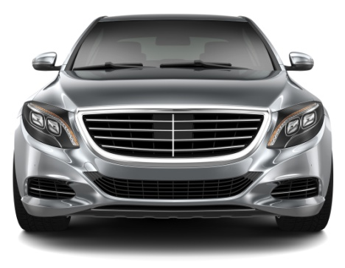
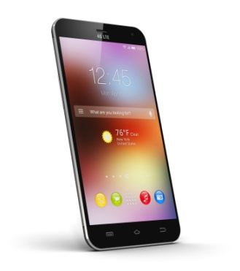
Now, you!
What is it?
1 - It’s made of metal and other materials, it’s used for communication. It isn’t allowed in some public places.
2 - It’s found everywhere. It’s used to go from place to place.
3 - It’s made of leather and it’s used to play soccer and other sports.
Notes:
TEACHER: Ask students to read the descriptions and identify the objects.

Slide 10
Check.
1 - It’s made of metal and other materials, it’s used for communication. It isn’t allowed in some public places.
2 - It’s found everywhere. It’s used to go from place to place.
3 - It’s made of leather and it’s used to play soccer and other sports.
3
2
1
Notes:
TEACHER: Ask students to check and see if they’ve gotten it right.

Slide 11
Game: Descriptions
* A dictionary
* A newspaper
* Scissors
* Pizza
* A credit card
Notes:
TEACHER: Have students write descriptions of the objects given. They can only use the Passive Voice. Ask them to work in pairs. They will have to guess which objects their partners are describing.

